Slide 1
Lists Part 1
- By
Hemlata Kohin

Slide 2
Today’s Objectives
• To learn about lists and what they are used for
–To be able to create and update lists
–To learn different ways to mutate a list
–To understand the syntax of lists
• To be able to use the membership “in” operator
• To understand how functions and methods differ

Slide 3
Introduction to Lists

Slide 4
Exercise: Average Three Numbers
• Read in three numbers and average them
num1 = int(input("Please enter a number: "))
num2 = int(input("Please enter a number: "))
num3 = int(input("Please enter a number: "))
print((num1 + num2 + num3) / 3)
• Easy! But what if we want to do 100 numbers? Or 1000 numbers?
• Do we want to make 1000 variables?

Slide 5
Using Lists
• We need an easy way to hold individual data items without needing to make lots of variables
–Making num1, num2, ..., num99, num100 is time-consuming and
impractical
• Instead, we can use a list to hold our data
–A list is a data structure: something that holds multiple pieces of
data in one structure

Slide 6
Lists vs Individual Variables
• Individual variables are like sticky notes
–Works best when you only need a few
–Good for storing different “pieces” of info
• Lists are like a checklist written on a single piece of paper
–Best for storing a lot of related information in one place

Slide 7
Properties of a List
• Heterogeneous (multiple data types!)
• Contiguous (all together in memory, sharing a common border)
• Ordered (remain in the order they were set in)
• Have instant (“random”) access to any element
• Are “mutable sequences of arbitrary objects” (Can be modified)

Slide 8
Creating and Modifying Lists

Slide 9
Creating an Empty List
• To create an empty list, use square brackets:
newList = []
–This creates a list variable called newList, with no elements in the
list
–(Sort of like a new checklist on a blank page)
• Similar to how we create an empty string:
newString = ""

Slide 10
List Method: append()
• The append() method lets us add items to the end of a list, increasing its size
• Syntax:
listName.append( itemToAppend )
• Useful for creating a list from flexible input
–Can start with an empty list, and add items as the user requests
them

Slide 11
Example of append( )
• We can use append( ) to create a list of numbers (using a loop to control how many)
values = [] # initialize the list to be empty
count = 0 # count how many numbers added
while count < 4:
userVal = int(input("Enter a number: "))
# add value to the list
values.append(userVal)
count += 1
print (values)

Slide 12
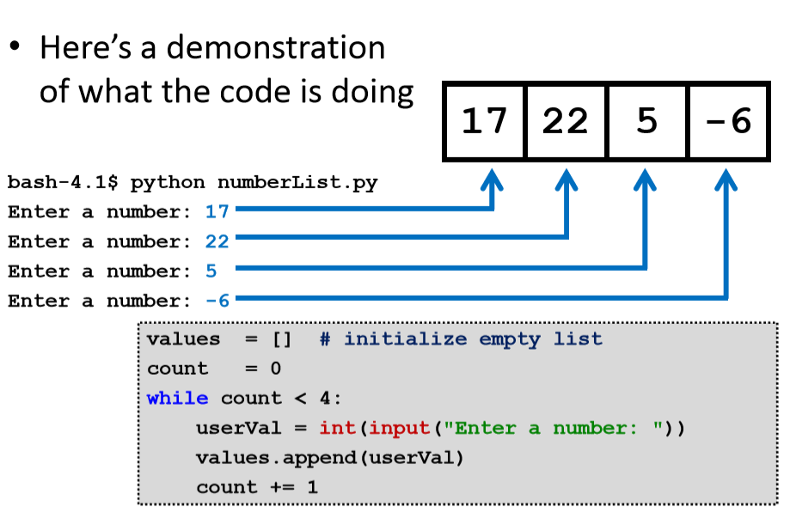

Slide 13
List Method: remove()
• The remove() method lets us remove an item from the list
–specifically, it finds and removes the first instance of a given value
Syntax:
listName.remove( valueToRemove )
• Useful for deleting things we don’t need

Slide 14
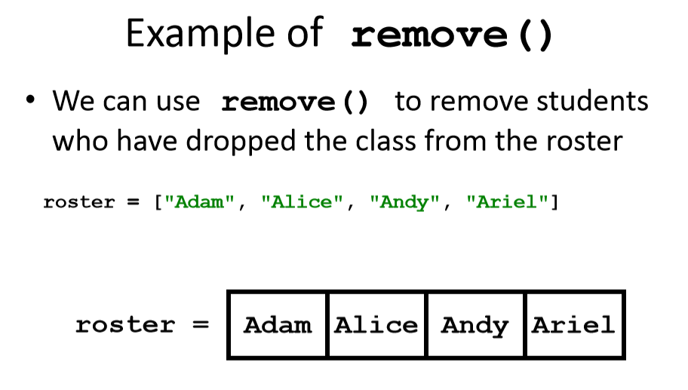

Slide 15
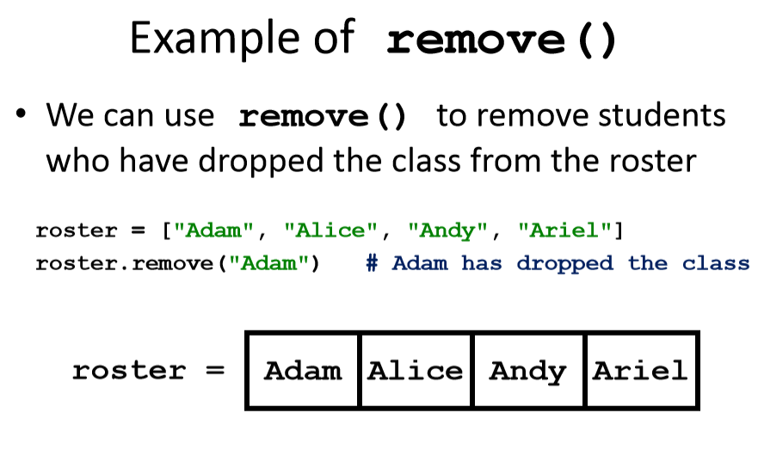

Slide 16
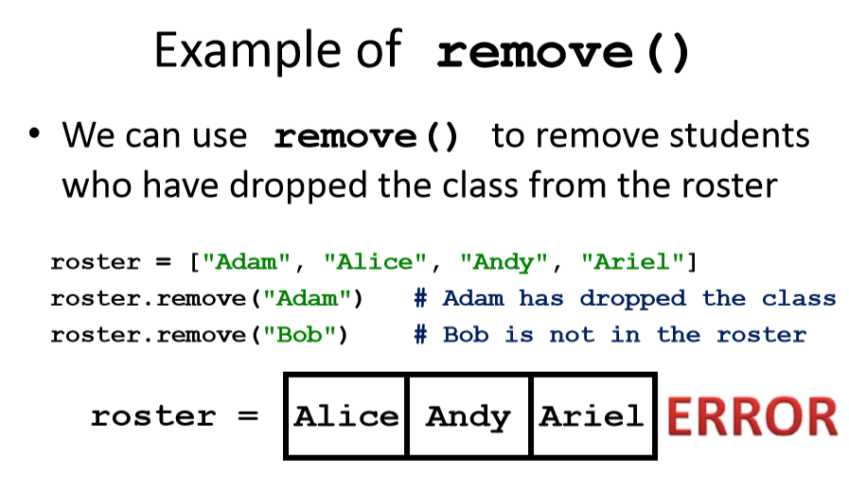

Slide 17
Quick Note –Methods vs Functions
• Functions include things like
– print()
– input()
– int()
• Methods are a bit different, and include
– .append()
– .remove()

Slide 18
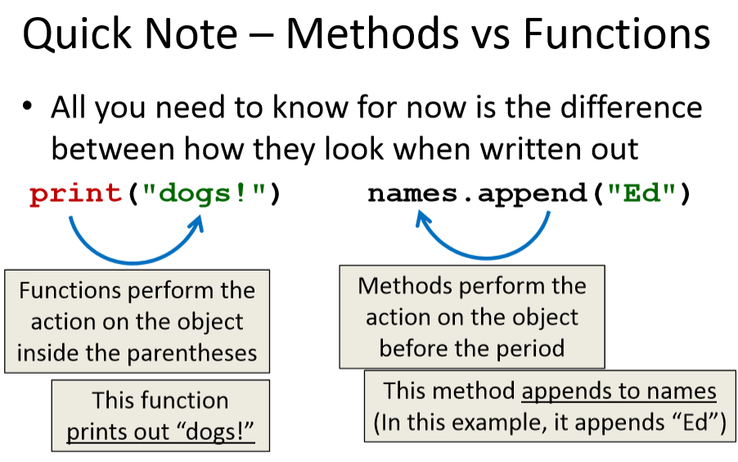

Slide 19
Lets Learn some more List Methods
Suppose there is a list of 5 friends
Friends = [“Kevin”, “Karen”, “Jim”, “Oscar”, “Toby”]
– They are indexed as [ 0,1,2,3,4]
A List can also put Boolean and numbers in the list
– Friends = [“Kevin”, 2, False]
– For now we’ll take the above as the example
Print(Friends)
– Will print all the items of the list
– Remember that the variables are case sensitive

Slide 20
Indexing in Lists
print (Friends [0]) –Prints only the index item of the list
–Here it’ll print only Kevin
print (Friends [-1])
–Will print out the first value from the end
–Here it’ll print Toby because it is last in the list
print (Friends [1:])
–Will print the values from index 1
– Will print ["Karen", "Jim", "Oscar", "Toby"]
Print (Friends [1:3]) – Will print out Karen and Jim only [From 1 and before 3]
Friends [1] = “Mike” –Change the indexed value to Mike

Slide 21
List Methods
For example lets take two lists
1) Lucky_numbers = [4, 8, 15, 16, 23, 42]
2) Friends = [“Kevin”, “Karen”, “Jim”, “Oscar”, “Toby”]
Friends.extend(Lucky_numbers)
print (Friends)
This will print the list ‘Friends’ first and then extend it to the other list ‘Lucky_numbers’
Extend is the Method

Slide 22
List Methods
Friends = [“Kevin”, “Karen”, “Jim”, “Oscar”, “Toby”]
Friends.append(“Creed”)
–Will add another friend to the list friends
Output- [“Kevin”, “Karen”, “Jim”, “Oscar”, “Toby”, “Creed”]
Here, append is the method

Slide 23
Difference between Extend & Append
Append: Adds its argument as a single element to the end of a list. The length of the list increases by one.
Syntax: list_one.append(“Element”)
extend(): Iterates over its argument and adding each element to the list and extending the list. The length of the list increases by number of elements in it’s argument.
Syntax: list_one.extend(list_two)

Slide 24
List Methods- Insert
If you want to insert a certain element in between the list you can do so by using the insert method
Friends.insert(1, “Kelly”)
–Will insert Kelly at index 1 and push the others to the right side of
the list
Output – ["Kevin", " Kelly ", "Karen", "Jim", "Oscar", "Toby"]

Slide 25
List Methods
Friends.clear()
–Will get rid of the entire list
Output- []
Friends.pop()
– Get rid of the last element of the list
Output- ["Kevin", "Karen", "Jim", "Oscar"]

Slide 26
List Methods
Friends.index(“Kevin”)
–Will tell if Kevin’s in the list by providing its index number
syntax:
element= Friends.index("Kevin")
print (element)
Friends.count(“Mike”)
–Will count the number of Mikes
syntax:
element= Friends.count("Mike")
print (element)

Slide 27
List Methods
Friends2 = Friends.copy()
–Create a copy of friends and paste it into Friends2
print (Friends2)
– Learn all about the methods here:
https://www.programiz.com/python-programming/methods/list/sort

Slide 28
Square Bracket Syntaxes
• Can use [] to assign initial values
myList = [1, 3, 5]
words = ["Hello", "to", "you"]
– (Also called initialization)
• And to refer to individual elements of a list
>>> print(words[0])
Hello

Slide 29
Length of a List
• To get a list’s length, use the function len()
>>> dogs = ["Lacey", "Kieran", "Al"]
>>> len(dogs)
3
>>> len([2, 0, 1, 9])
4
• Why would we need the length of a list?
–We’ll see in the next few slides!

Slide 30
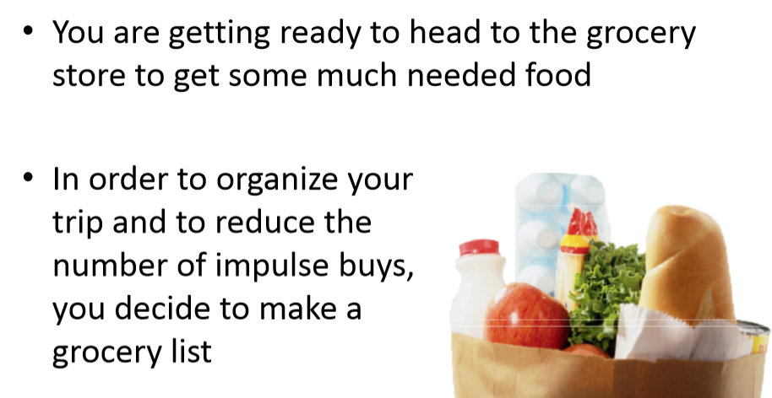
List Example: Grocery List

Slide 31
List Example: Grocery List
• Inputs:
–3 items for grocery list
• Process:
–Store groceries using list data structure
• Output:
–Final grocery list

Slide 32
Grocery List Code
MAX_GROC = 3
def main():
print ("Welcome to the Grocery Manager 1.0")
groceryList = [] # initialize empty list
# get grocery items from the user
count = 0
while count < MAX_GROC:
item = input("Please enter an item: ")
groceryList.append(item)
count += 1
main()

Slide 33
Iterating Over a List
• Now that we have our grocery list, how do we iterate over each
element of the list and print out its contents?
list and print out its contents?
–Hint: Use a while loop and the len() function!
index = 0
while index < len(groceryList):
print (groceryList[index])
index += 1

Slide 34
Sentinel Values and while Loops

Slide 35
When to Use while Loops
while loops are very helpful when you:
Want to get input from the user that meets certain specific conditions
Positive number
A non-empty string
Want to keep getting input until some “end”
User inputs a value that means they’re finished
Reached the end of some input (a file, etc.)

Slide 36
Sentinel Values
Sentinel values “guard” the end of your input
They are used:
When you don’t know the number of entries
In while loops to control data entry
To let the user indicate an “end” to the data
Common sentinel values include:
STOP, -1, 0, QUIT, and EXIT

Slide 37
Sentinel Loop Example
Here’s an example, where we ask the user to enter student names:
students = []
name = input("Please enter a student, or 'QUIT' to stop: ")
while name != "QUIT":
students.append(name)
name = input("Please enter a student, or 'QUIT' to stop: ")

Slide 38
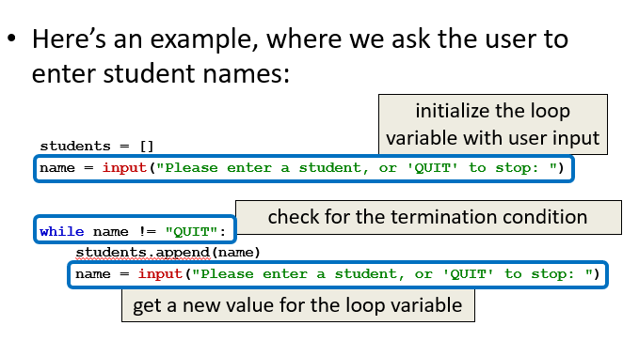

Slide 39
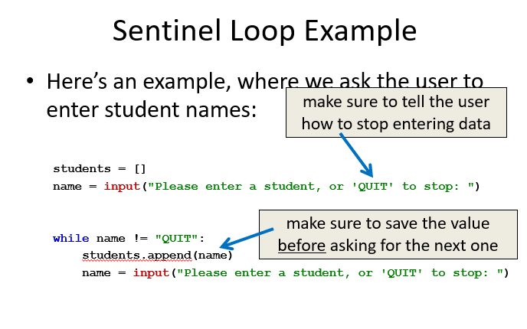

Slide 40
Membership “in” Operator

Slide 41
Membership Operator Example
• What do you think this code does?
colors = [“orange", “purple", “red", “blue"]
guess = input("Please enter a color name: ")
while guess not in colors:
print("You guessed wrong!")
guess = input("Guess again: ")
• Runs until the user guesses a color in the list
–The membership operator can be very useful

Slide 42
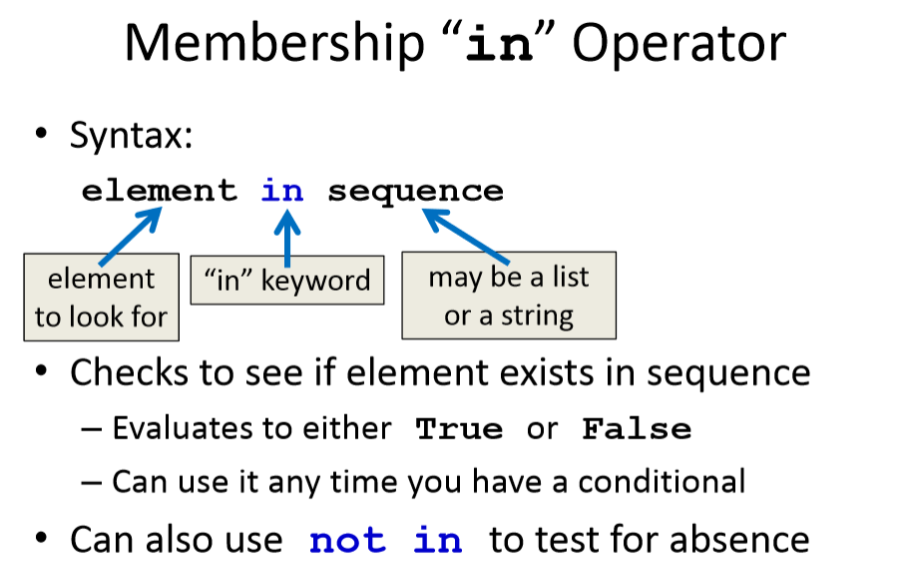
Membership “in” Operator

Slide 43
HW 08: Updated Grocery List
• Let’s update our grocery list program to allow as many items as the
user wants, using a while loop and a sentinel value of “STOP”
–Print out the grocery list (item by item) at the end
• You will need to use:
–At least one while loop (a sentinel loop)
–Conditionals
–A single list

Slide 44
Any Questions?

